Slide 1
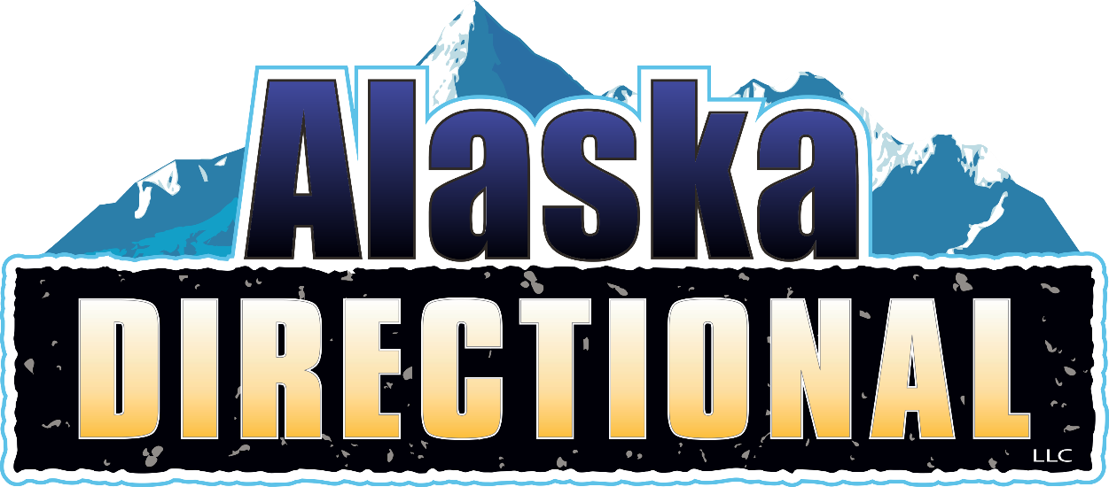

Slide 2
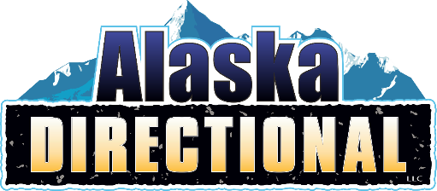
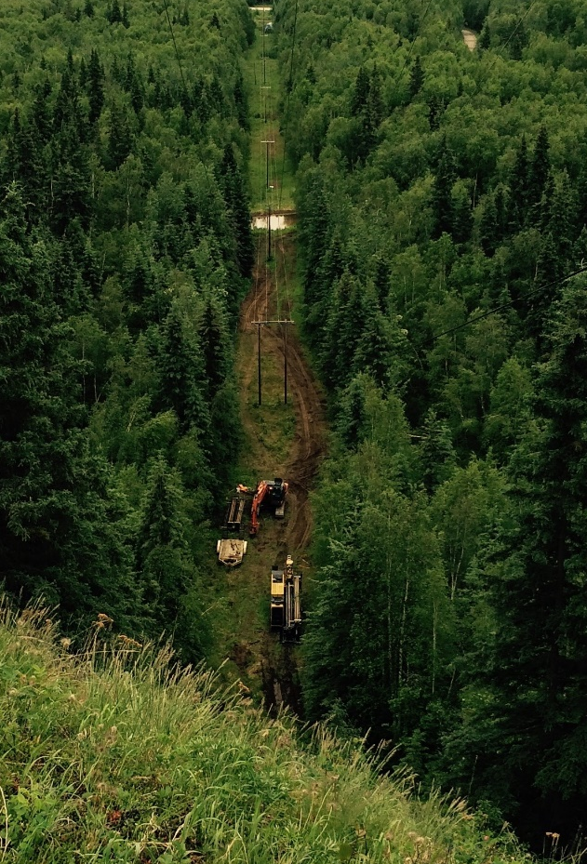
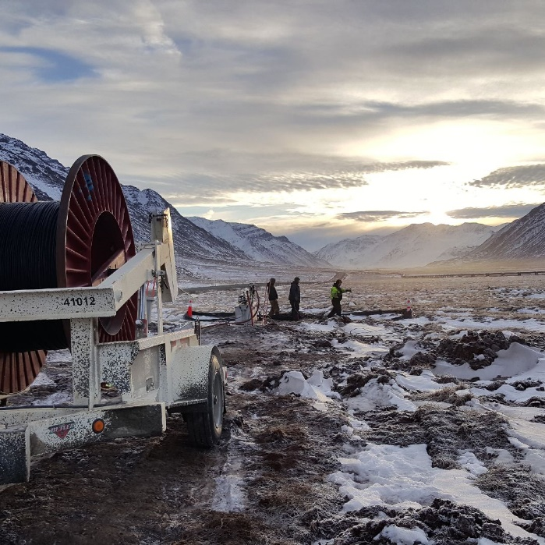
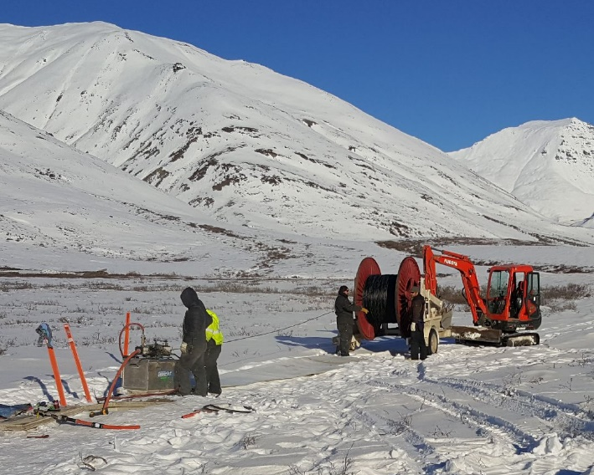
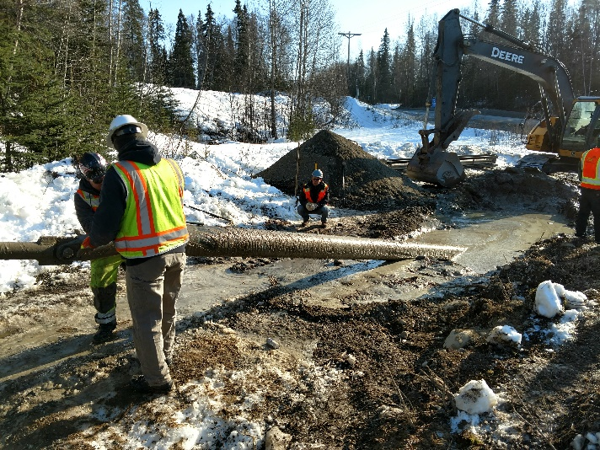
Company Overview
Alaska Directional, LLC is a company based in Palmer, Alaska. We have over 100 years in combined experience within the industry.
We offer complete job build-outs: project planning, directional drilling, natural gas lines, pipeline, water, telephone overhead, utility installation, underground
installation, fiber optic placement,
splicing, and terminations.

Slide 3
Our Vision
As an Alaskan-owned and operated company, our mission is to exceed industry standards utilizing the latest technology and the highest safety standards. Our team is fully trained in every aspect of project management, directional drilling, trenching,
plowing, communications
Infrastructure,
and more.

Slide 4
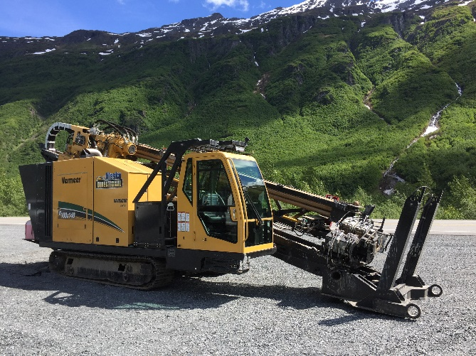
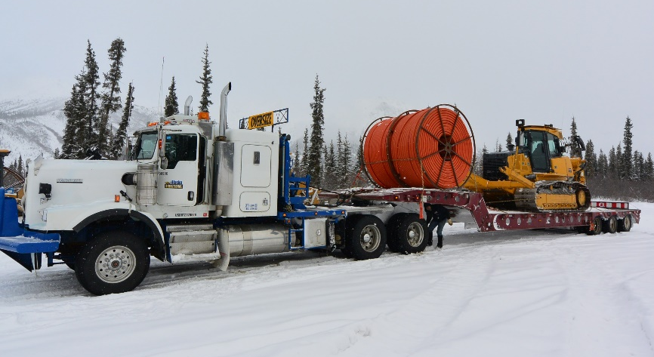
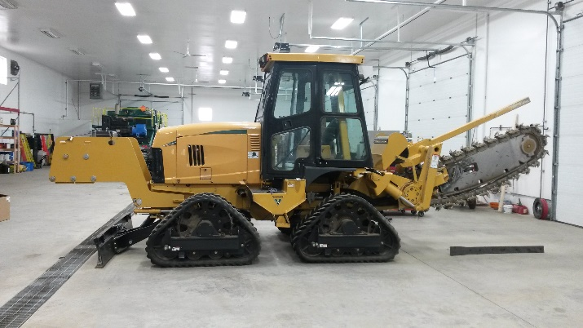
Fleet
Alaska Directional, LLC maintains a fleet of new, top of the line equipment and employs a full-time crew of mechanics to reduce equipment breakdowns, downtime, and ensures timely completion of projects.
Our equipment is uniquely adapted to Alaska’s changing and difficult climate thus allowing us to
excel at projects year-round
with a full-time crew of
the industry's best.

Slide 5
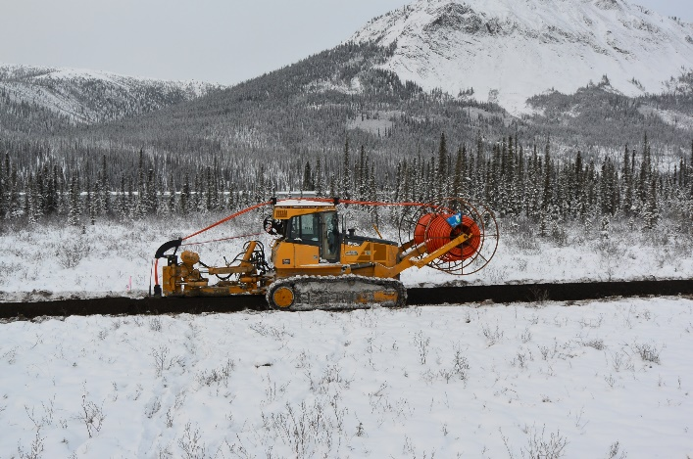
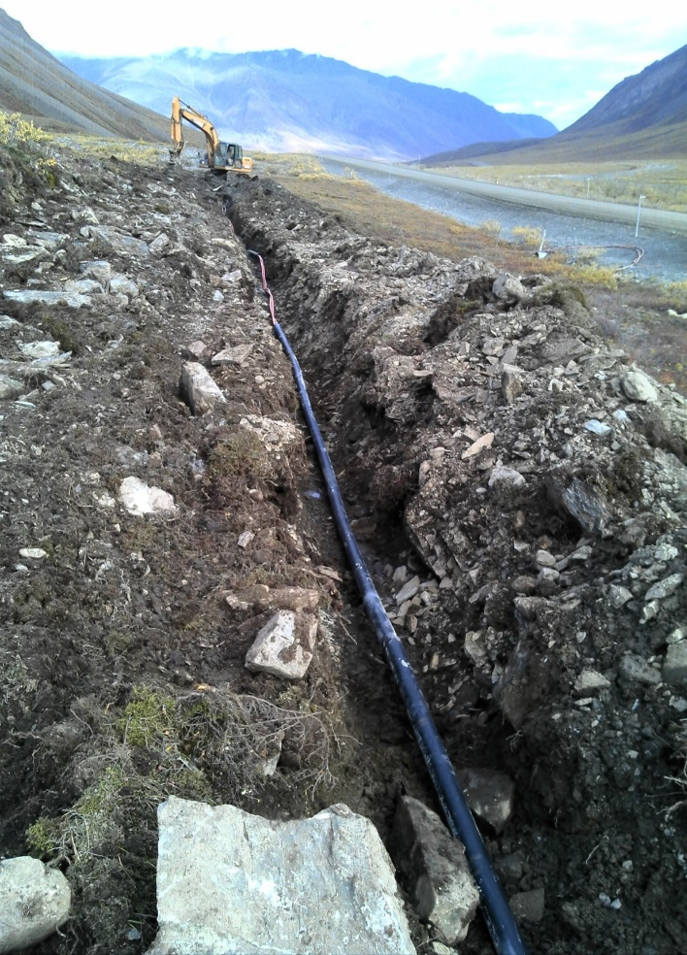
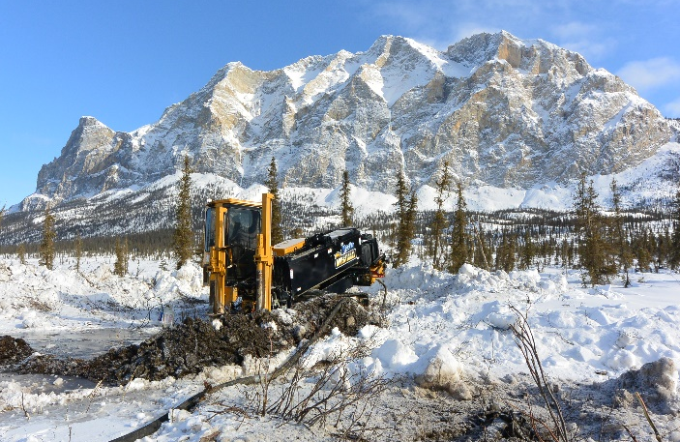
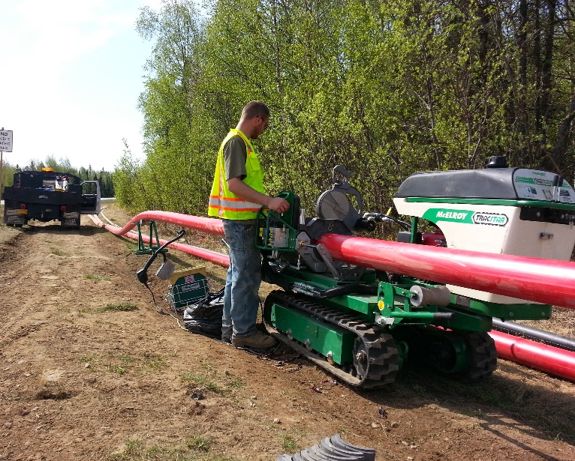
Service Capabilities
Telecommunications
Fiber and copper Splicing
Drilling Capabilities over 3000ft
Natural Gas Distribution and Mains
HDPE Fusion and Testing
SWPPP Certified Staff
Traffic Control Certified Staff
Gas OQ Certified Staff
Water and Sewer
Flex Steel

Slide 6
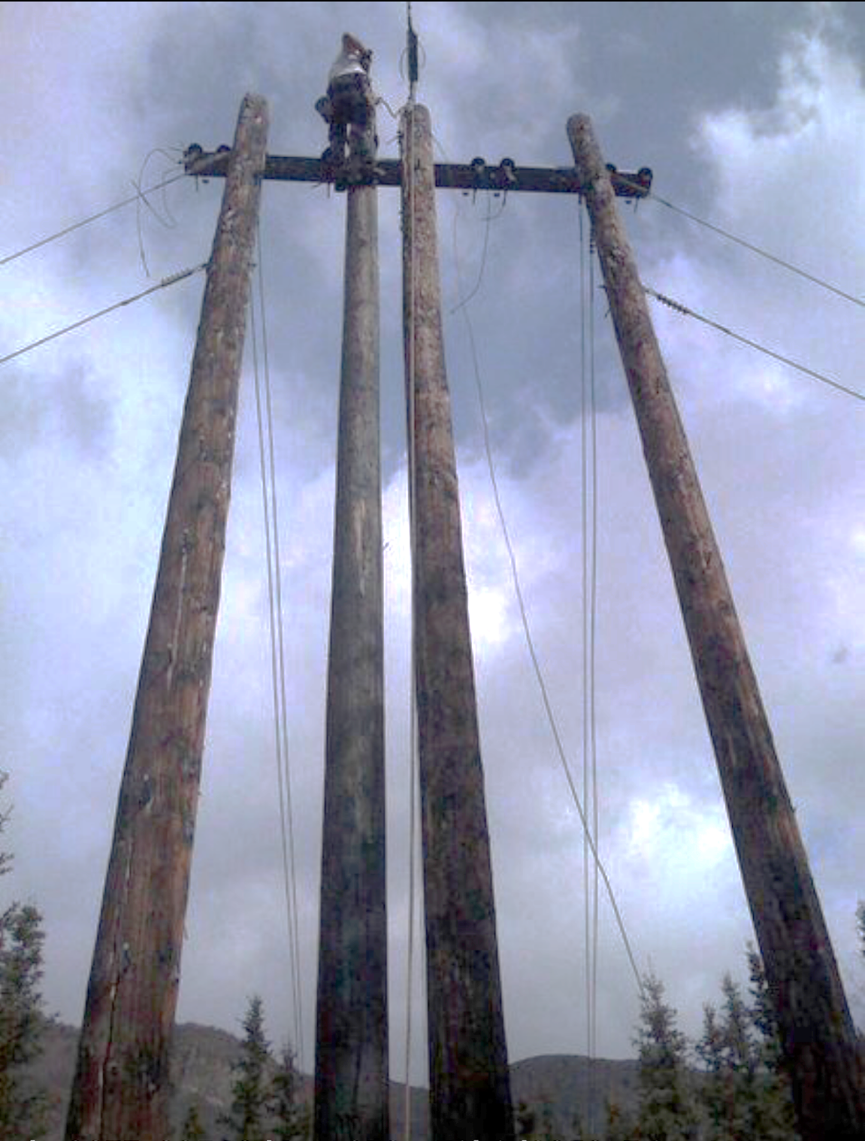
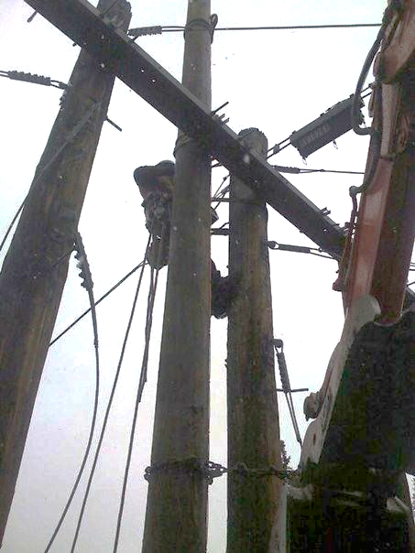
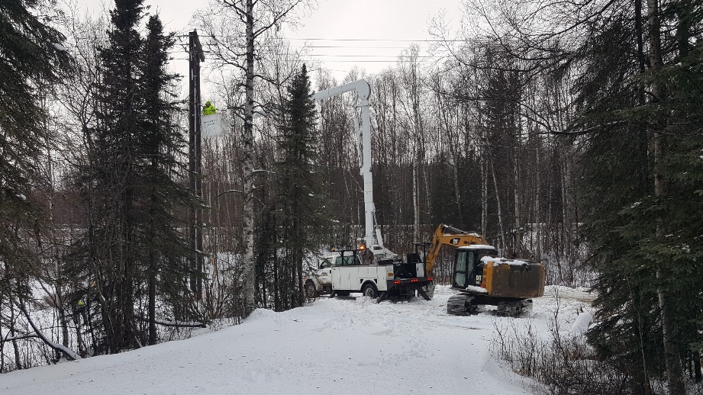
Service Capabilities
State of Alaska Electrical Administrator
Project Design & Consulting
Horizontal Directional Drilling
Overhead and Underground Utility Installation
Trenching
Pipeline
Plowing

Slide 7
Projects – Long Haul
Dates | Project | Project Info
2021-Current | Nicey Phase 1 Cordova Telephone Cooperative | 17 miles Fiber Optic Installation along the Copper River Hwy by Trench, Plow, Drilling, Fiber blowing, splicing and testing.
2020-2021 | OSP Healy to Fairbanks Alaska Communications Services | 180 miles Fiber Optic installation by Trench, Plow, drilling, fiber blowing and testing.
2019-2020 | Alcan 1 – Fairbanks to Canada Border MTA Fiber Holdings, LLC | Design Build of 300 Miles Fiber Optic installation by Plow, Trench, drilling, splicing and testing. Complete installation of Fiber, Vaults and Handholes. Subcontractors used for Engineering, Surveying and clearing.
2015-2017 | Quintillion/New Horizons Telecom. | 125-mile fiber optic cable line installation in remote Alaska. Trench, plow, HDD installation of HDPE through all types of ground conditions. All season.
2015-2016 | New Horizons Telecom./ACS Moose Creek project | 75 mile fiber optic line installation. Trench, plow, HDD installation of HDPE through all types of ground conditions. All season.

Slide 8
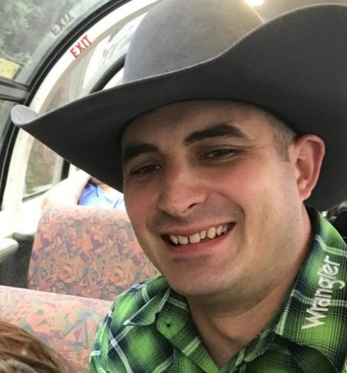
Management Team
Brad Lindstrom
CEO
6+ years of experience in the underground and drilling construction. Bachelors in Finance
brad@alaskadirectional.com
Tim Rathbun
EVP of Operations and Electrical Administrator
17+ years of experience in underground and overhead communication construction with 8+ yrs as project manager.
trathbun@alaskadirectional.com
Brad Shephard
Chief Operating Officer
23+ years experience in underground and overhead construction to include splicing of copper and fiber optic systems.
bshephard@alaskadirectional.com

Slide 9
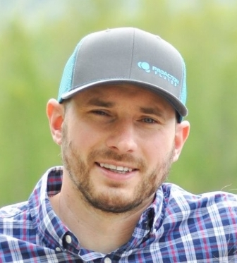
Management Team
Michael Wilson
Equipment Manager
17+ years experience maintaining and managing equipment in Alaska
mwilson@alaskadirectional.com
Chris Faeo
Drilling Manager and
Safety Manager
24+ years of arctic and subarctic experience in drilling and operations, project engineering and system design.
cfaeo@alaskdirectional.com

Slide 10
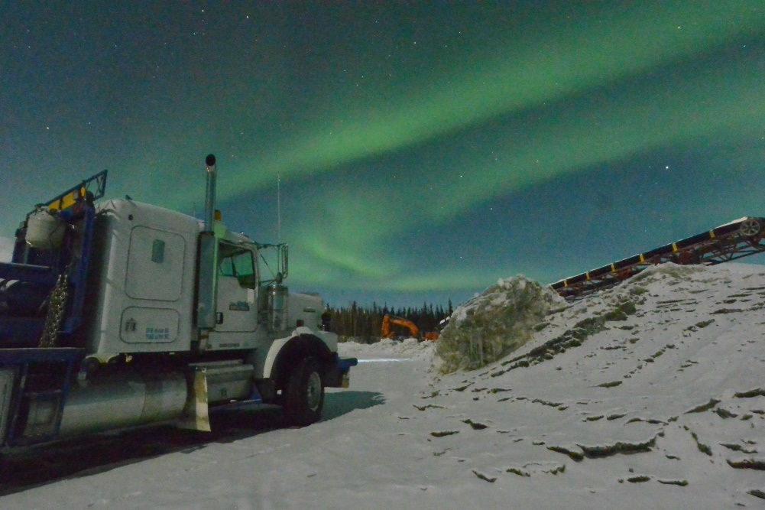
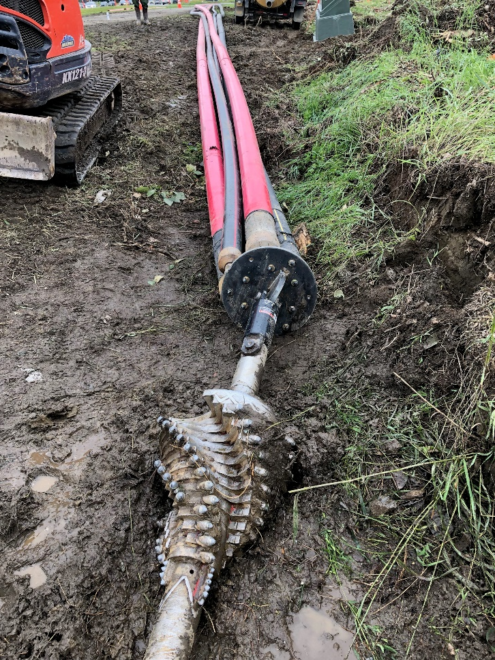
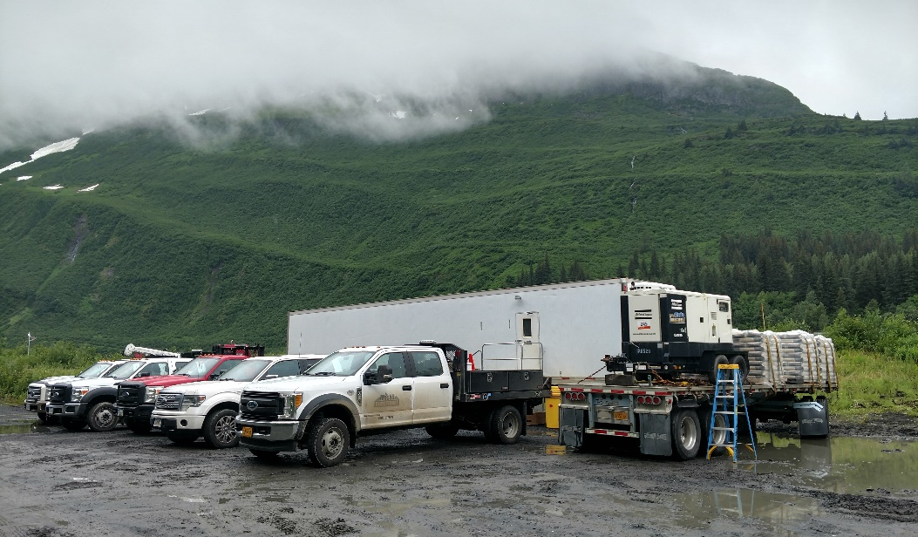
Contact Us
akdirectional@alaskadirectional.com
200 E. Commercial Dr.
Palmer AK, 99645
(907) 357-9015
Alaskadirectional.com

